Slide 1
Sprint2
CSCE799 – Midterm Review

Slide 2
Cocky Cipher Suite
Client
User SSO, Client Configuration, Cipher Negotiation
Any Cipher we can code that can provide PCI, and HIPAA Compliance.
This is essentially a requirement to eliminate all observable customer information for payments or otherwise on disk and in transit. That’s more than a discussion of SSL technology.
Caesar-3, Caesar-7, AES, 3DES, CockyDefault(OverNTP), CockyDef2(Over Network Scrambled), and CockyExtreme(Stream) which goes to 16bit codes are what I am planning to support client to server.
To support a suite of Ciphers from client to server:
Must have a Bootstrap API
Must have an Auth API
Must have a Time API to verify for thick clients and servers they have ntp enabled and working.
Api Bootstrapper
Server

Slide 3
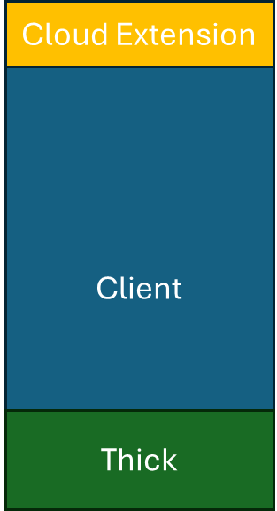

Cocky Cipher Suite Overview w/o Proxy
Cloud Extension
Cloud Disk
Under Steady State Clients Access Web Pages Over HTTP/HTPPS
Web Service
Browser
RAM Disk
Server
OS
Browser Memory Other
Rest Service
SQLite Cookies
Use of Cocky Cipher Technology
Browser
Session
REST Ports Usually run on 50000-60000 ports default by MS Compilers
Browser
Local Storage
OS Mem
Gen Disk
Internet Or Enterprise
IP Connectivity Over X
Std Ports 80,443, 8443, 8080 Web
Router
Ports 50000-60000 Dynamic Rest UDP-QUIC/TCP Traffic with HTTPS/HTTP

Slide 4
Application Basics
Web Pages and Web Data Run out of band from each other in a REST model.
This means there are 4 options – (16 Combinations)
  With or Without Application Encryption (Clients-Server Other)
  With or Without Network Encryption for Web. (Web Service)
  With or Without Network Encryption for Data (REST Service)
  With or Without Other Network Encryptors/Hardware, etc.
With a Proxy there are 5 variables (32 Combinations)
  With Or Without Network Encryption to the Web Server TO URL1 TO WWW
  With Or Without Network Encryption to the Web Proxy TO URL2 TO REST
  With Or Without Application Encryption
  With Or With Other Network Encryptors/Hardware.
  AND New With or Without SSL From Web Proxy to REST Service.
If all 4 types of security are enabled using modern tools it would require a state/gov actor and a court order to decrypt client-server traffic in transit or in stored form.

Slide 5
Laws and Compliance
Most Countries Differentiate Laws For
  Stored Communications (Already on Disk or in Databases)
  Network Communications (Real Time Distribution of Streams)
In the United States
  Stored Communications Act Governs Requirements for reviewing data on Disk.
  Real Time Surveillance Seen to be a 4th Amendment violation (See Katz v US) by Supreme Court of US. Prosecuted under Color of Law Statutes.
  Other State Laws and Provisions.
Crimes Have To Be Proven Based on Criminal Intent
  An Encrypted Block of Text even a Caesar Encoded one… establishes intent for a criminal process.
  Without Application Encryption No Basis for Criminal Prosecution exists. Users can argue they happened on the materials in question by accident.
Most Large Companies Have a Different Shared Service IT Leader From Business Unit CIOs who set Risk & Compliance policies for their division. That means network and BU’s have different constraints.

Slide 6
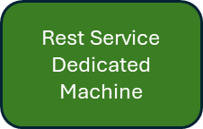
Cocky Cipher Suite w Proxy – Simple Transport Model
Cloud Disk
Cloud Extension
Browser
RAM Disk
Browser Memory Other
Web Service
Web Server(n)
Dedicated
Machine
Use of Cocky Cipher Technology
Server
OS
SQLite Cookies
Under Steady State Clients Access Web Pages Over HTTP/HTPPS
Browser
Session
Browser
Local Storage
OS Mem
Gen Disk
REST Ports Usually run on 50000-60000 ports default by MS Compilers
But are often load balanced
Internet Or Enterprise
IP Connectivity Over X
Std Ports 80,443, 8443, 8080 Web
Router

Slide 7

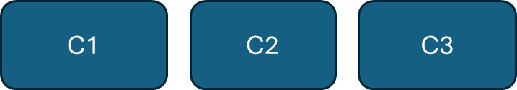
Hub and Spoke Internet Models With Encryption Models
Hub1
West
Web/Rest
Hub2
East
Web/Rest
Conc Router2
C4
C5
C6
C1-C6 Receive the Same Encryption Keys in Caesarian Models

Slide 8

Encryption - Per Session Models
Hub1
West
Web/Rest
Hub2
East
Web/Rest
Conc Router2
What Are My Keys - Bootstrap
C4
C5
C6
C1-C6 Receive Different Keys in Per Session Models

Slide 9
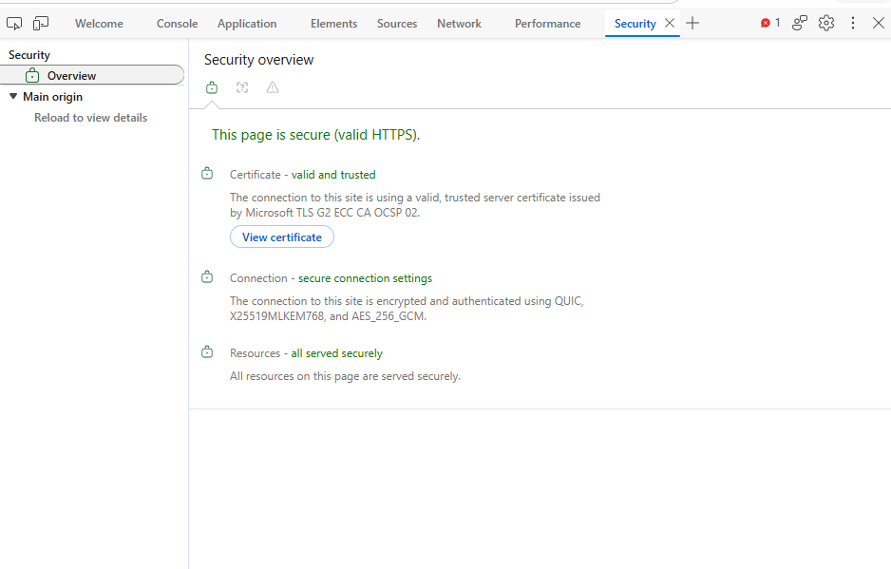
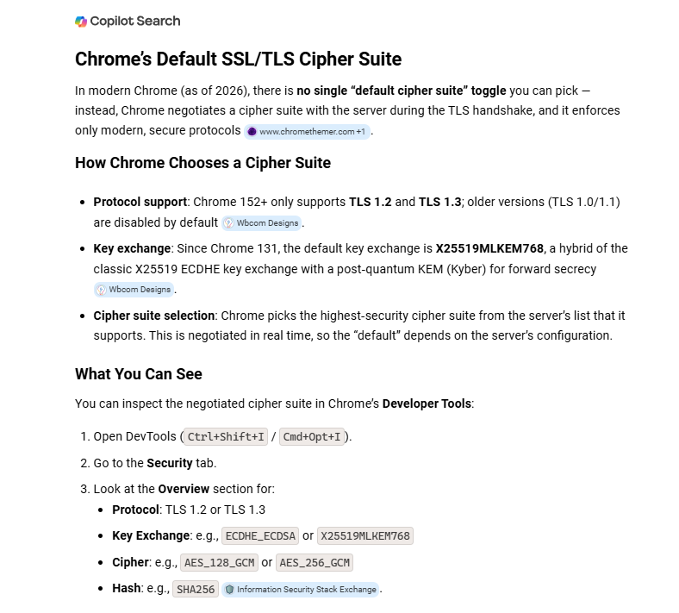
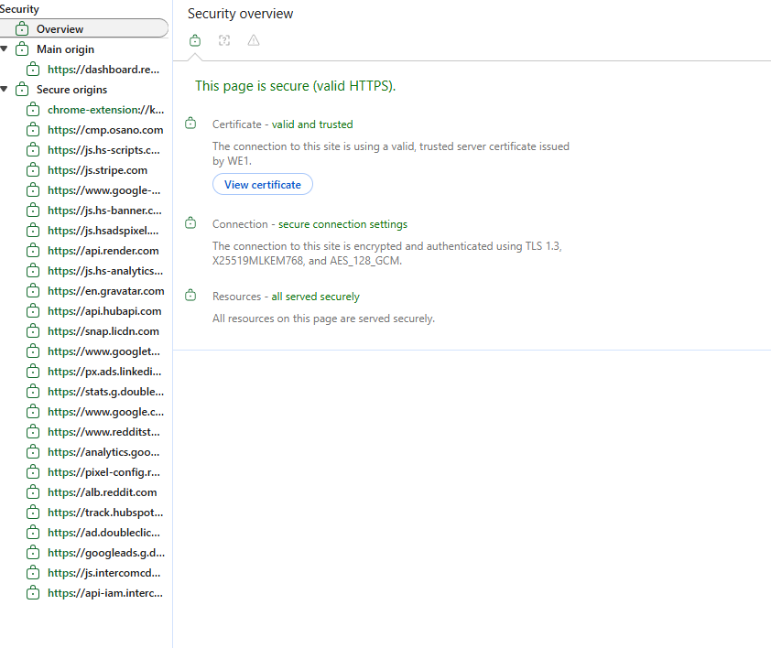
Some Perspective… Chrome Defaults to AES128
SC.EDU TO BING… AES256
SC.EDU
TO RENDER
AES128

Slide 10
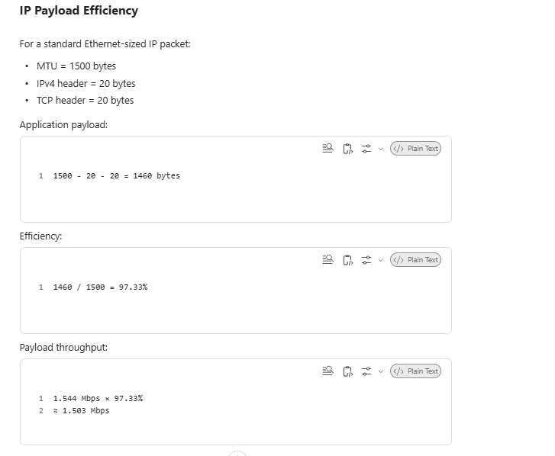
Cipher Operations
Key0 – Generates A0 of Key Text Shifted 96 positions to the right.
Plain Text
ASCII Text
8 bit encoding
Key1 – Generates A1 or Key Text Shifted BaseShift + NTP(MOY)
Key2 – Generates A2 = K1 + NTP(DOM)
Key3 – Generates
A3 = K2 +3
Plain Text Block Assumed to be 1460 Bytes/characters at Base
5 Arrays Are Built in Default Model on Client Bootstrap. These are essentially just binary values shifted in the Key Value.
Key4 – Generates
A4 = K3 + 4
Key Max in Default =
96+12+31+3+4+5
Key(N) – Generates
AN-1 = KN-1 + N

Slide 11
The BASICS OF THE COCKEY CIPHER
Key0 is The base shift which defaults to 96 in Binary. Arrays are Now All Present in Memory on Client and Server.
1
256
Key1
Key(n)

Slide 12
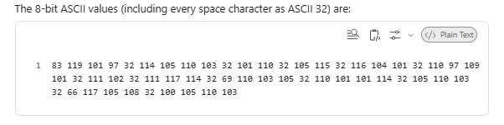
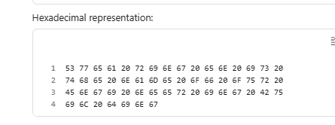
Encrypt(m) – Standard Form.
(m) = Swearingen Is the name of our Engineering Building
Pass 1 we inject a space at each 5th position
(Md1) = Swea ring en is the name of our Engi neer ing Buil ding
(We add a space to every5th position – could be tuned to 3, 4, 6, any value.
(Md2) = Md1 to ASCII
(Md3) Final – Codes based on their position are remapped to the encryption matrix in Linear time. A simple loop from (i to 1460). This is two assembler instructions or perhaps 1 and requires no multiplication. O(n).
Eg 83 -> Key{0, 96+83}
Eg 119 -> Key(1, 96+119+MOY) = Key1
Ed 101 -> Key(2, Key1 + DOM) = Key2
This is matrix shifted algorithm similar to the Enigma or Vigenère's Array of Subsitutions Model.

Slide 13
Encrypt(m) – Advanced Form
(m) = Swearingen Is the name of our Engineering Building
Pass 1 we inject a space at each 5th position
(Md1) = Swea ring en is the name of our Engi neer ing Buil ding
(We add a space to every5th position – could be tuned to 3, 4, 6, any value.
(Md2) = Md1 to ASCII
(Md3) Final – Codes based on their position are remapped to the encryption matrix in Linear time. A simple loop from (i to 1460). This is two assembler instructions or perhaps 1 and requires no multiplication. O(n).
Eg 83 -> Key{0, AO{83}
Eg 119 -> Key(1, A0{119)
Ed 101 -> Key(2, A2{101))
In this model the N arrays of 8bit values are sent over the wire. There is no shift. Just an array of binary values. This is a random 8 bit code block.

Slide 14
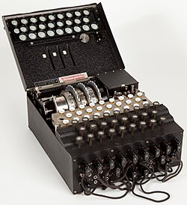
Engima (A Four Wheeled Device)
https://en.wikipedia.org/wiki/Enigma_machine
The Arrays of Text We have built in Memory Are More Secure than Enigma Machine which used only 26 Latin Letters. But had 26exp4 permutations possible.
We are using (N) number of keys with 5 being the base on 8bit codes which are 256exp5 permutations. 10x larger than the original.
Whats different? (1) our first pass, breaks words into smaller sub-words. (2) CockyCiphers can be modified per stream making encryption all but impossible except for Nation States. (3) Advanced Versions using 16bit or 32bit multiplicators (4) Possible to scramble all five arrays randomly per stream using Network Streams from REST Bootstrap Making the Cipher a Matrix Cipher.

Slide 15
Classifying Our Algorithm?
Substitution Cipher -> Fixed Shift. (Letters – 1 Permutation)
Substitution Cipher -> Random Shifts -> Monoalphabetic Substitution Cipher-> CG Melon (26! -1)
Substitution Cipher -> Adv Random Shifts -> ASCII Based Substitution Cipher -> (256! -1) [IE JUST ASCII]
Array Block Cipher -> Binary Matrix Variant – VignereCipher+ -> Array Substitution Cipher (256!) exp 5.
Enigma Radial Cipher -> 4 Wheel Encoding Machine -> Array Substitution Cipher(26!) exp 4.
The Vigenère cipher had a starting single key. Our has 5 that include day mutators.
The Vigenère cipher used 26 characters, were are using ASCII shifted values with 256 values.

Slide 16
Securing… One App
Cocky Analytics(v4) from Cocky Investments(v2)

Slide 17
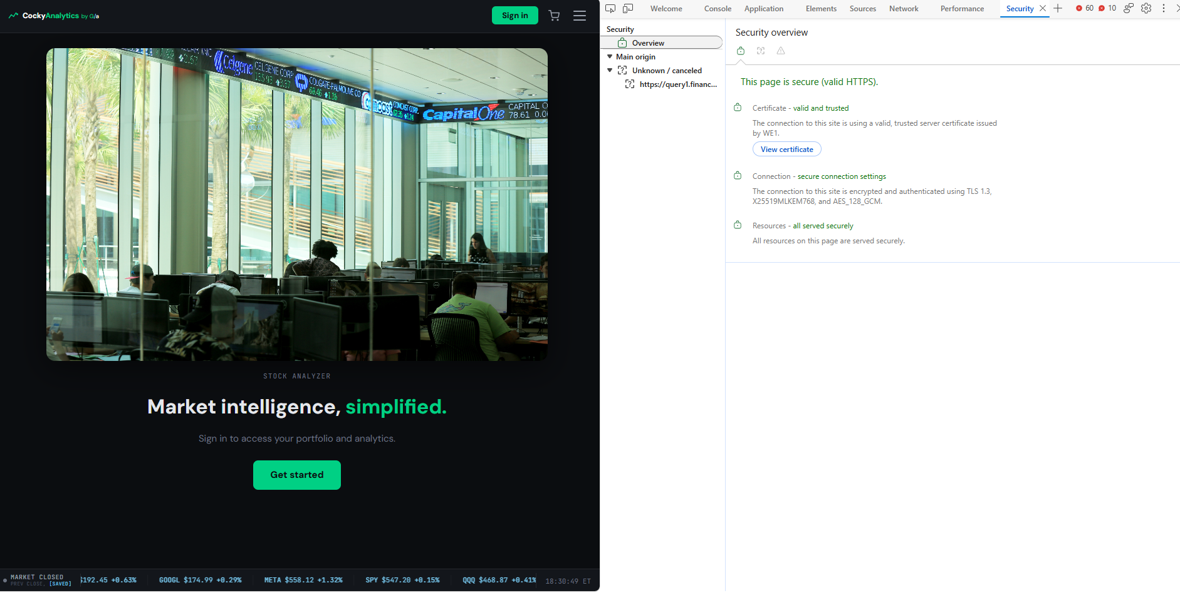
The End Goal… Clients Running Cocky Analytics Securely…. And Storage Areas Encrypted

Slide 18
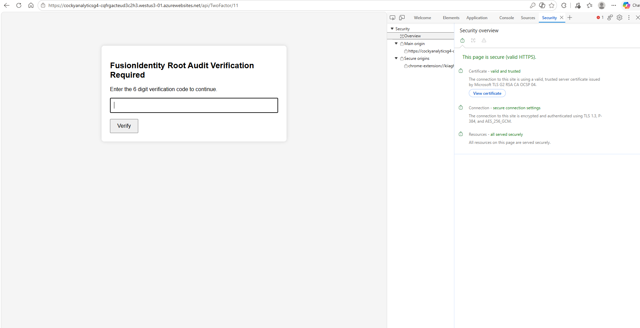
API Layer on Azure…
Running over Azure HTTPS with TwoFactor

Slide 19
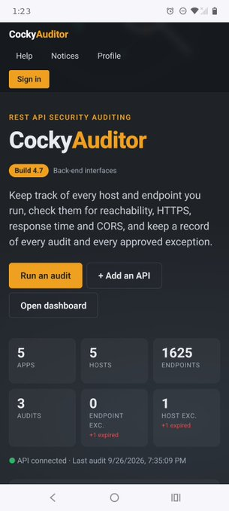
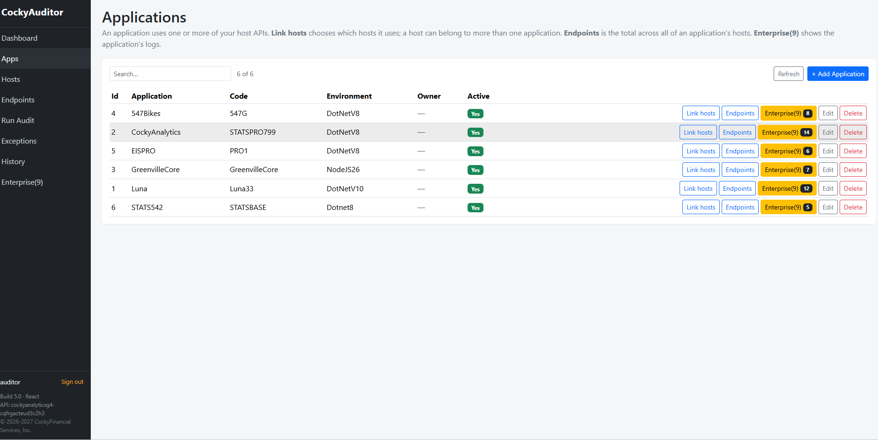
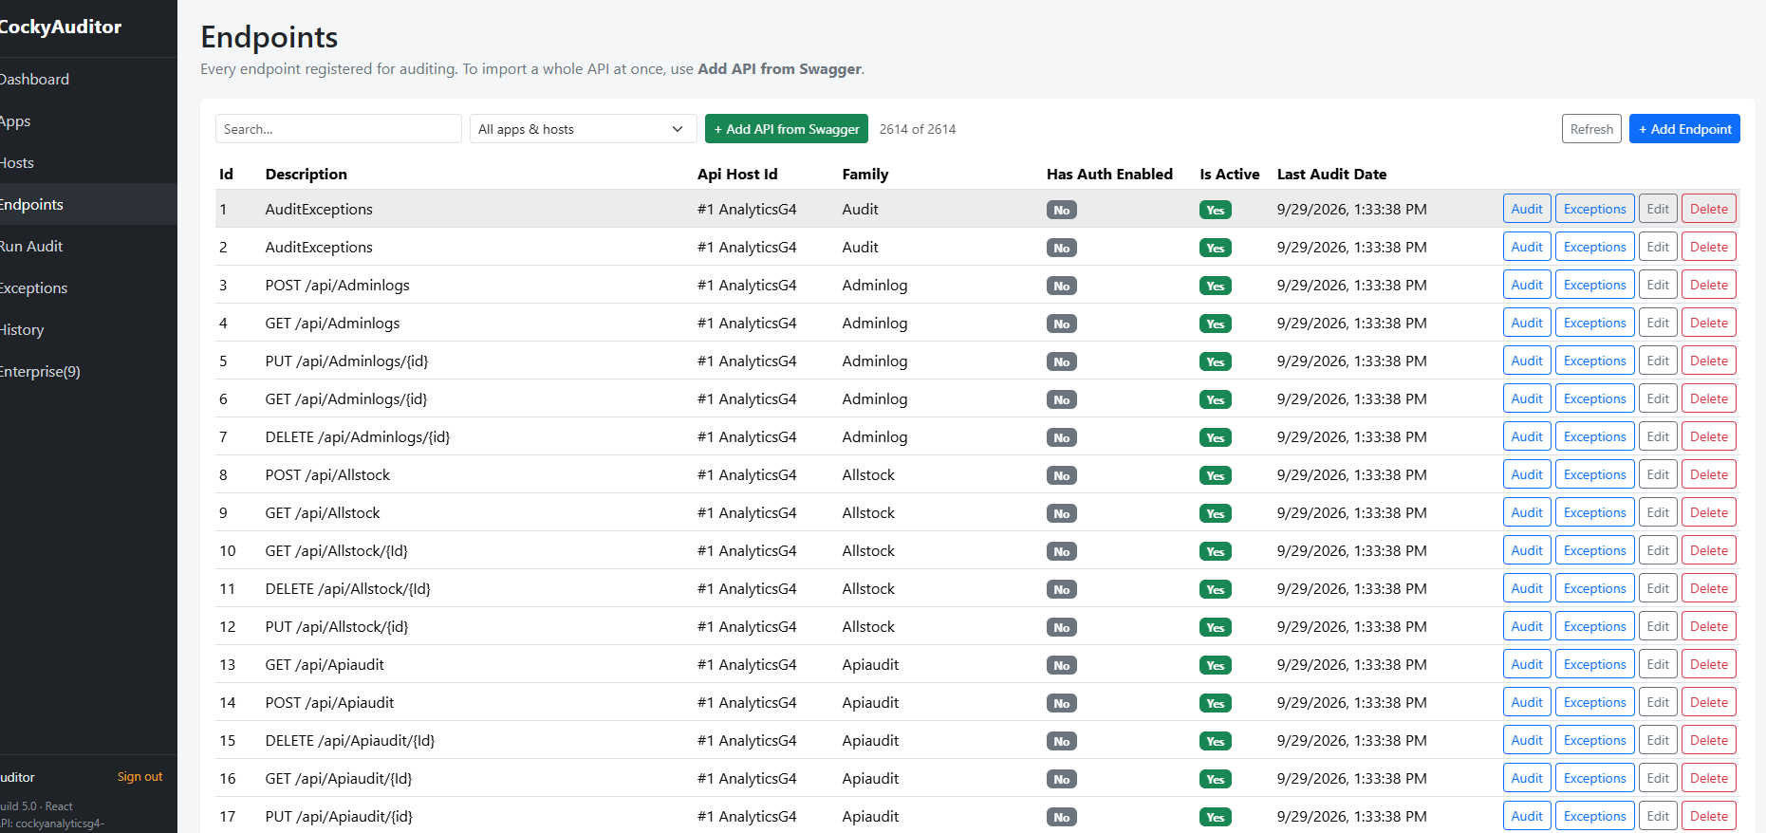
New CockyAuditor Platform
Supporting Both HTML, and React Formats to Common API Layer.

Slide 20
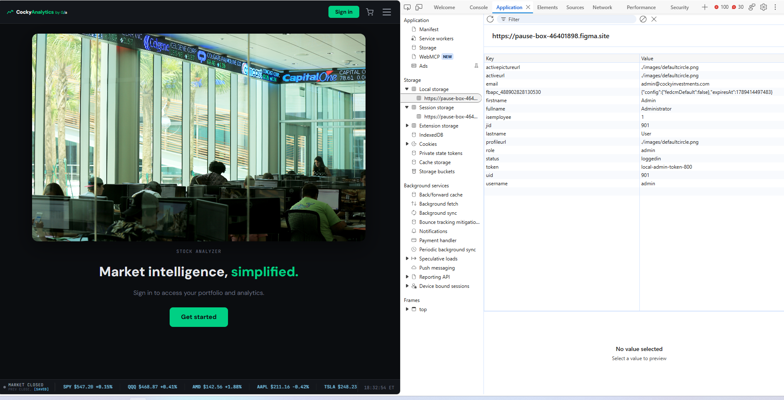
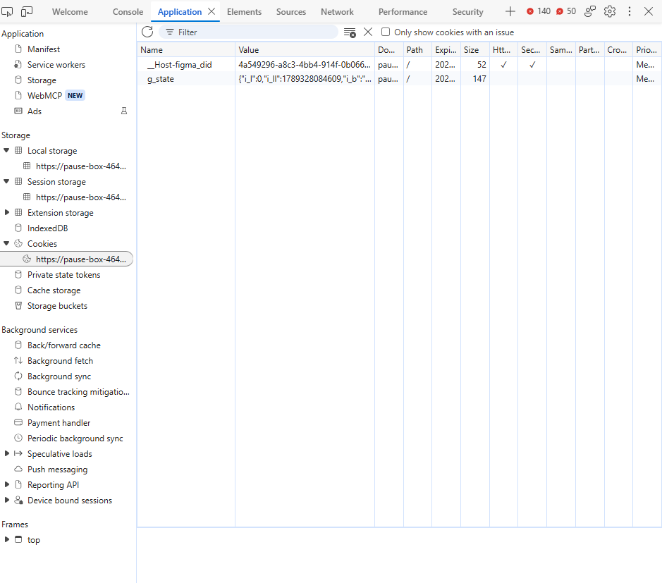
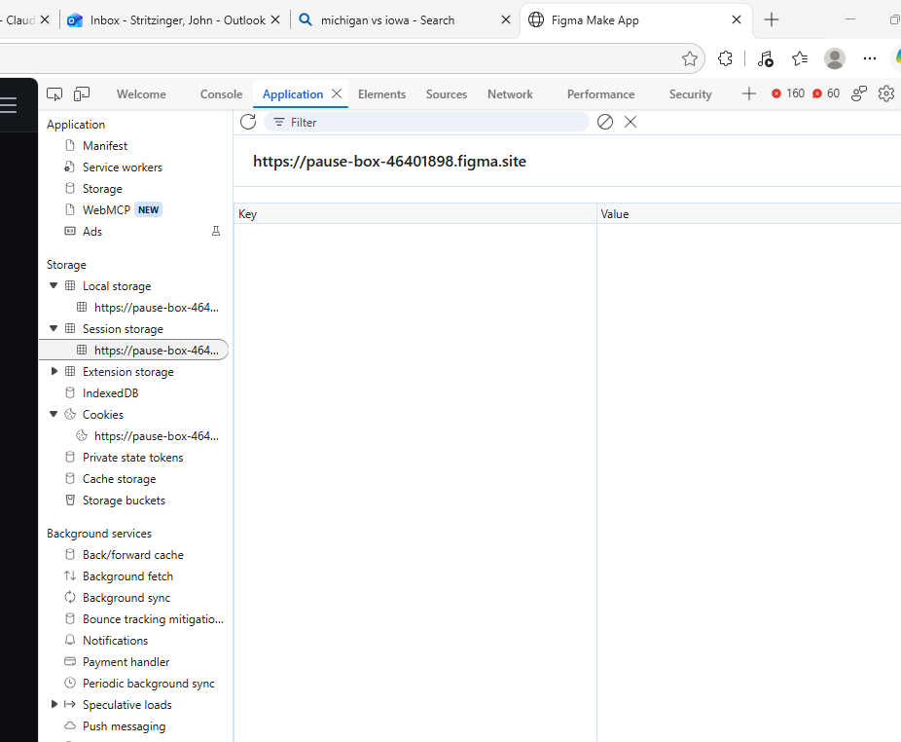
And All PCI Data Masked
CockyCipher to Encrypt All Browser Information

Slide 21
Market Trends
09/30/2026

Slide 22
Object Oriented Programming to REST APIs
When you develop functions in any major programming language (java, c/c++, python, ruby, C#, objectiveC, javascript, PHP, C#) variables are passed as parameters to functions, and values are returned.
REST APIs simply deliver functions across a Network Boundary. DotNet C#, and NodeJS Express API have effectively allowed functions to be run not on a local workstation but across networks.
C# Controllers, and NodeJS controllers are the functional interfaces. They are defined with inputs/outputs just like any OOO coding mechanism.
Whats New? Well when you hook a Functional Model to a Model View Controller(MVC) you can run Server-Side Code to an entire backoffice or create standalone agents on any device.
But Legacy OOP model speak any programming language… while REST APIS have a native language of JSON objects. JSONS go in, JSONs go out which is much more restrictive.
Client
(With Local And Remote Functions)
Networks
API
(Functions Accessed Remotely)
REST Functions Speak “JSON”

Slide 23
Sockets Programming… Eliminated…
Historically Sockets Programming was a CIS5XX-CIS7XX class after an engineer had at least three years of programming experience, and at least two classes on networks.
Sockets Programming allows for any data structure to be passed over a network in any form…. But….
Getting data to a peer doesn’t get any work done. There is no MVC, no database connectivity, and EVERYTHING IS ICB.
Necessarily Sockets Programming will never be used by anyone who already knows how to program using REST with MVCs. It doesn’t buy anything in practice…. except higher security options.

Slide 24
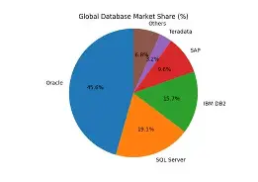
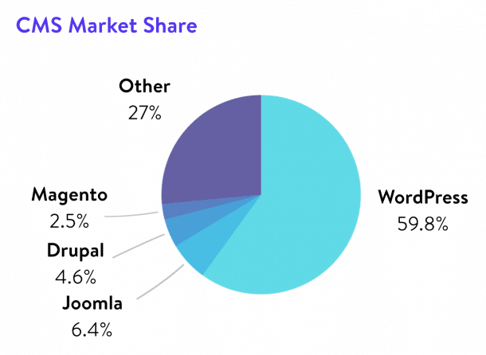
Commercial Database Layers Moving To REST
Historically Oracle OCI Drivers, and Microsoft Visual Studio Grid Objects > 90% Market Share Since 1990.
  Driving Thick Client Connectivity Direct to Databases.
  2nd Level Orchestration Platforms Built For Synchronization, and Management Dashboarding.
    (Eg Ivanti/Intel Landesk Manager, IBM NetCool, Kratos NeuralStar)
Circa 2000
  Code Behinds from HTML Became the Rage
  Java with JDBC Drivers
  ASP.NET Pages with Microsoft ODBC Solutions
  Adobe ColdFusion
  JQUERY, AJAX over XML new types of data connectivity over HTTP Posts.
  Code Behind Market Share Increasing > 20% Anecdotally.
  Legacy Coding Models Frozen or Queued For Port.
  VDI Becomes Popular for Thick Clients rather than Redevelopment for Remote Users (Citrix, Windows Terminal Server).
  Roy Fielding PHD Dissertation on Standardization of HTTP/HTTPS Posts (University of California)
By 2015
  WordPress(80%+ CRM Marketshare), Joomla, and Drupal the largest 3 CRM tools added REST API capabilities to their platforms.
  Microsoft, NodeJS, Django on Python all REST Variants.
  All Major Cloud Providers (AWS, Azure, Google, Oracle, IBM, HP-EDS) over API Provisioning
  Social Media Companies over SSO Over OATH2 (Facebook, Google, LinkedIn, Yahoo, Apple).
By 2020
  All Major AI Providers have a full API layer, and programmatic links to major development platforms like VSCode.
Gartner Doesn’t have stats… but my expert opinion is that API Backends are now > 80% of all new development simply because to use Cloud Native Interfaces you have to use it…. And Financial Institutions will not finance small IT projects with infrastructure.

Slide 25
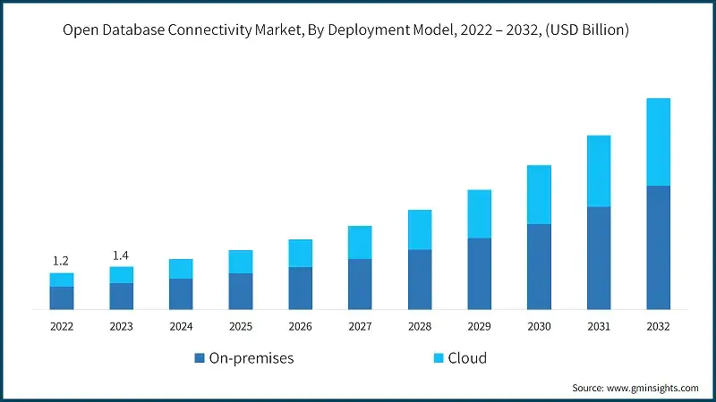
Database Models Moving Behind MVC > 90%
Client
REST
API
With
MVC
Database
Adapter
Layer
(ORM/EF)
SQL
Database
Node
Moving to a REST Model Lowers the cost of Database connectivity as Proprietary Microsoft, and Oracle OCI drivers which only speak to specific database types are no longer necessary. This “Commoditizes” the SQL DBMS Platform. DBMS tools offer effectively identical features with the exception of Replication Capabilities. Oracle, and MS-SQL are the only production platforms which can replicate ANY-ANY. MySQL requires a cluster Technology to replicate which requires many VMs/Machines (1 per Replication partner).

Slide 26
Clients Low Effective Security Compliance
In Large Enterprises IT Programs usually have 100’s to Thousands of Applications usually with many versions.
In Addition in the Fortune 100 usually these apps are distributed among core datacenters, and DR centers.
The result of tens of thousands of virtual machines, proxy servers and webservers in every combination.
We are seeking to mask all visible data on the client in memory, in the browser, and on disk.
Using “Banded/Imaged Machines” usually disk encryption is standardized. This can be part of the Operating System Windows/MACOS or as external encryption tools from third parties.
Application Encryption runs in the 10% range on only the most critical platforms outside of eCommerce Driven tools.

Slide 27
Requirements
Encrypt Applications
Secure REST Fabrics Client-Facing
Secure REST Fabrics Network-Facing
Secure Browser Temporary Spaces
  (Cookies, Local Storage, Session Storage)
Automate the Auditing of the Network.

